Slide 1
Where to start an Indian Restaurant in Silicon Valley, California.
- Varunkumarr C V

Slide 2
Introduction
As every computer engineer dream land Silicon Valley, let's explore where to start an Indian restaurant by analyzing Indian population and Indian restaurants in the dream land.
Major Silicon Valley cities are multi-cultural, we are going to analyze the situation in the following cities San Jose, Sunnyvale, Santa Clara, Mountain View, Palo Alto and Cupertino.
There are 4 million people in Silicon Valley out of which around 6% people are Immigrants from India.

Slide 3
Introduction (Contd.)
They are living far away from their native there is a high chance for them to miss their authentic native food.
Let’s think of it by investor, they expect to prefer a place where the Indians are more and Indian restaurants is less.
When we consider all these problems, we can create a map and information chart where the Indian restaurants is less with respective to Indian population.
Target People
Entrepreneurs who want to start a new business in Silicon Valley
Established vendors who want to open a new chain of their Indian restaurant in Silicon Valley

Slide 4
Data Description
To solve the above problem, we retrieved data from the source as listed below:
geopy API is used in this project to get the latitude and longitude coordinates of the respected cities.
Forsquare API is used to get the Indian restaurant venues around Silicon Valley.
Google Map, ‘Search Nearby’ option is used to get the center coordinates of each restaurants.
California population data is retrieved from zipatlas.com.

Slide 5
Methodology
Restaurant data preparation – Foursquare API
Population data preparation – Atlas.com
Analyzing and Merging - Restaurant and Population data
Exploring and Clustering the Indian restaurants in Silicon Valley

Slide 6
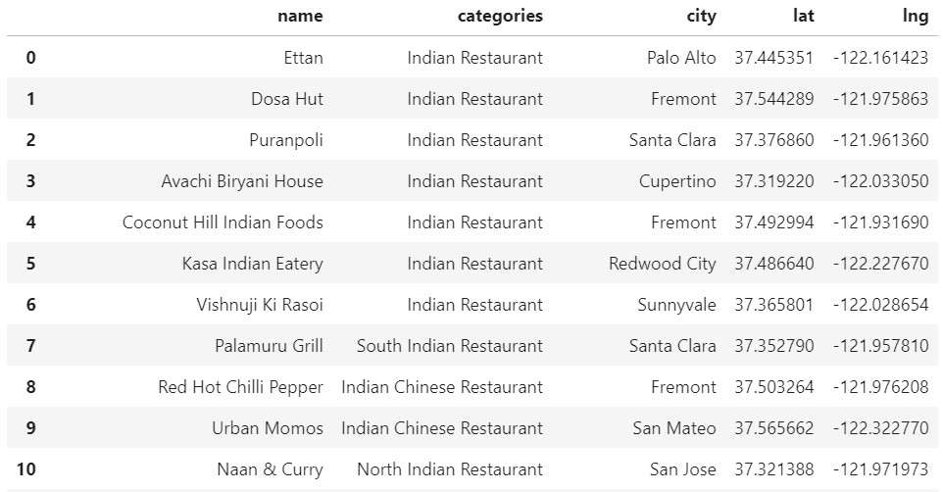
Restaurant Data

Slide 7
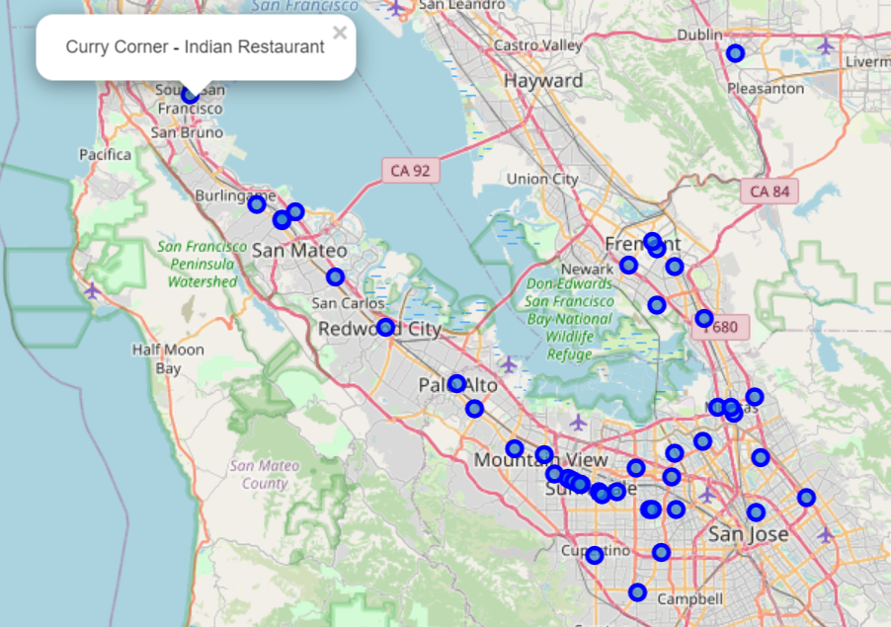
Restaurant Data (Contd.)

Slide 8
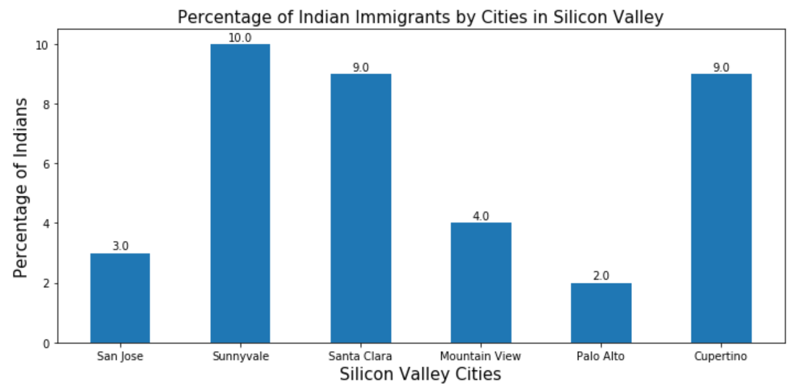
Population Data

Slide 9
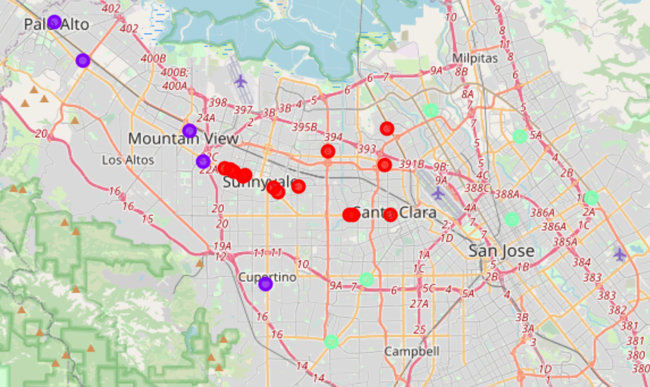
Clustered Dataset
K-Means unsupervised learning is used to cluster the restaurant based on its type

Slide 10
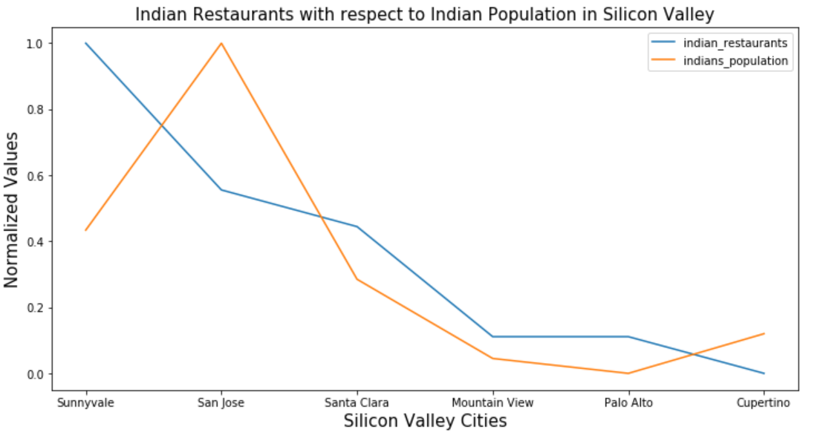
Results

Slide 11
Discussion
San Jose or Cupertino will give better results as the ratio of population with respect to restaurants is very high.
In future studies this project can be extended in two ways as follows,
In Silicon Valley, we can analyze the data for some other restaurants (Says Asian, Italian…)
We can pick another location (Says London, Canada) and find out the possibility of opening an Indian restaurant.

Slide 12
Conclusion
As a result, people are turning to big cities to start a business or work. For this reason, people can achieve better outcomes through their access to the platforms where such information is provided.
As already discussed, people love towards food will never fade away, they are always interested in trying out new varieties.
Not only for Entrepreneurs and Established Vendors but also for People who are reading this report will come to know about some idea of Indian Restaurants in Silicon Valley.

